Slide 1
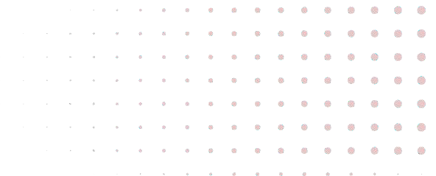
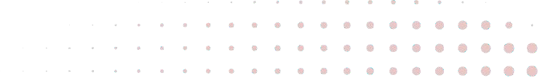
IMAGE SEGMENTATION WITH U-NET
Presented By :
Mohana Bhavani Tatikonda Sravya Kakumani
University of South Florida | 2024

Slide 2

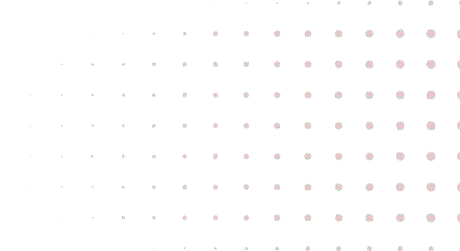
1
PROBLEM STATEMENT
Applying the U-Net architecture to do image segmentation. with the aim of making the image's representation simpler and/or more meaningful for easier analysis creatinga U-Net, a kind of CNN that can segment images quickly and accurately and use it to assign a label to every single pixel in an image.
University of South Florida | 2024

Slide 3
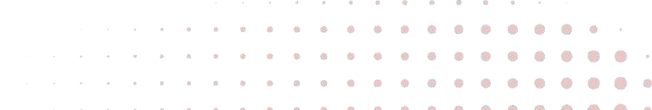
2
IMAGE SEGMENTAION
Image segmentation is a computer vision technique that partitions a digital image into discrete groups of pixels—image segments—to inform object detection and related tasks. By parsing an image’s complex visual data into specifically shaped segments, image segmentation enables faster, more advanced image processing.
It helps computers understand pictures by separating objects, like finding a dog or identifying organs in medical scans.
University of South Florida | 2024

Slide 4
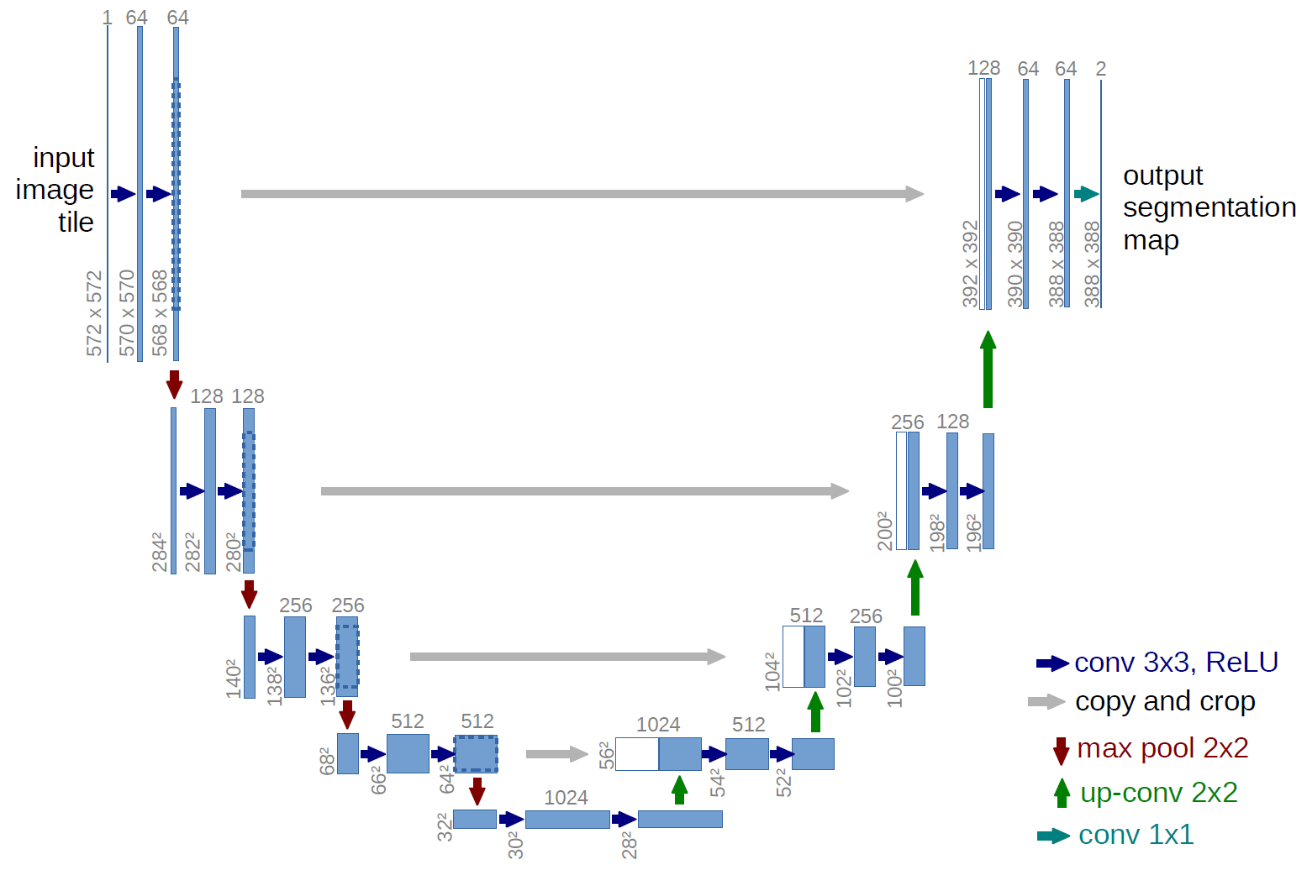
U-NET
3
University of South Florida | 2024

Slide 5
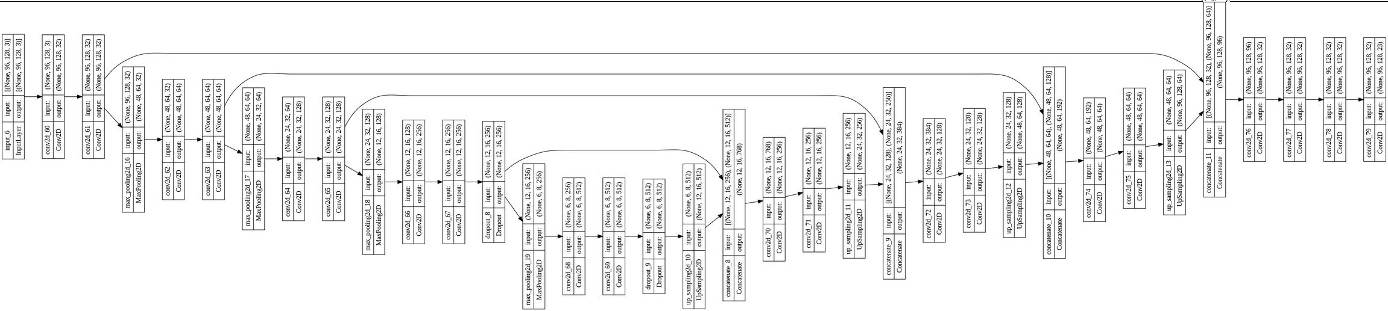
U-NET ARCHITECTURE
4
University of South Florida | 2024

Slide 6
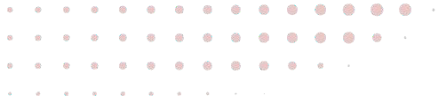
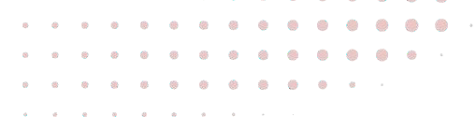
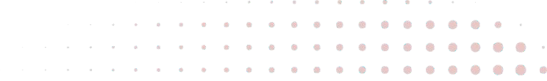
5
U-NET OVER FCN
Skip connections
Symmetric Architecture
Vanishing gradient

Slide 7
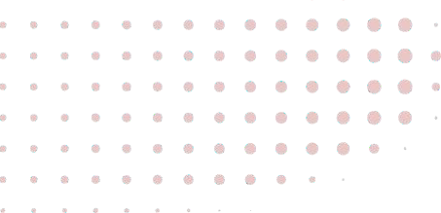
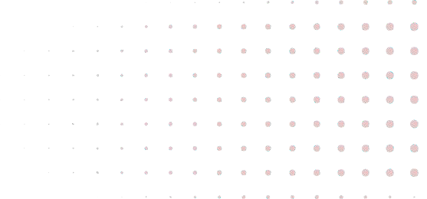
6
CONCLUSION
U-Net architecture has demonstrated remarkable performance in image segmentation tasks, outperforming traditional methods and even contemporary architectures like FCN in various scenarios. In the case of autonomous driving, where precise scene understanding is crucial for safe navigation, U-Net's capabilities can be harnessed to develop advanced perception systems. By accurately identifying objects and obstacles in real-time, U-Net-powered models can contribute to thecreation of autonomous vehicles that improve road safety and reduce accidents.
University of South Florida | 2024

Slide 8
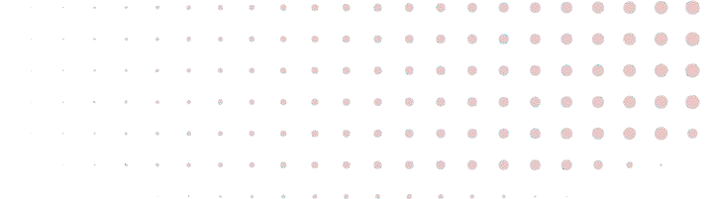
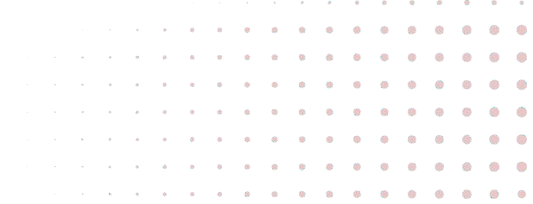
THANK YOU
University of South Florida | 2024

